Slide 1
UCOP Family
FEUD
USE OF PORTABLE
FIRE EXTINGUISHERS
JULY 2011 SAFETY MEETING
UNIVERSITY OF CALIFORNIA, OFFICE OF THE PRESIDENT

Slide 2

Fire Extinguisher Use
Annual Refresher Training for Use of Portable Fire Extinguisher
Cal/OSHA Safety Training Requirement
Review:
1) General Principles for Fire Extinguisher Use
2) Guidelines on When to Use a Portable Fire Extinguisher

Slide 3
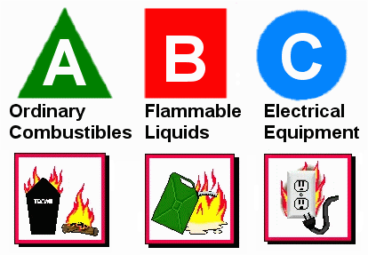
Major Types of Fires
Type A:
Combustible Materials
Type B: Flammable/Combustible Liquids
Type C:
Energized Electrical Equipment

Slide 4
When to Use a Fire Extinguisher
- Small & Contained
- Safe Escape Route Behind You
Extinguisher Rated for Type of Fire You Are
Fighting
Trained in Use & Confident You Can Operate it
Effectively
SLIGHTEST DOUBT – DON’T! Get Out. Close the Door to Slow the Spread of the Fire

Slide 5
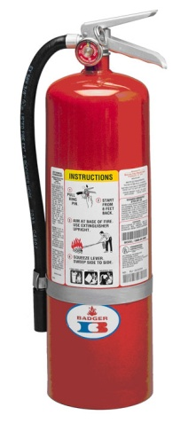
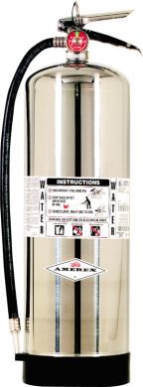
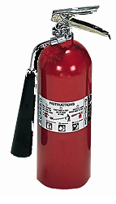
Types of Fire Extinguishers
Multi-Purpose (Red Color) – Dry Chemical
ABC (Ammonium Phosphate) or
BC (Potassium Bicarbonate)
Pressurized Water (Silver Color)
Type A Fire Only
Carbon Dioxide (Red Color with No Gauge)
Type BC Fire Only

Slide 6
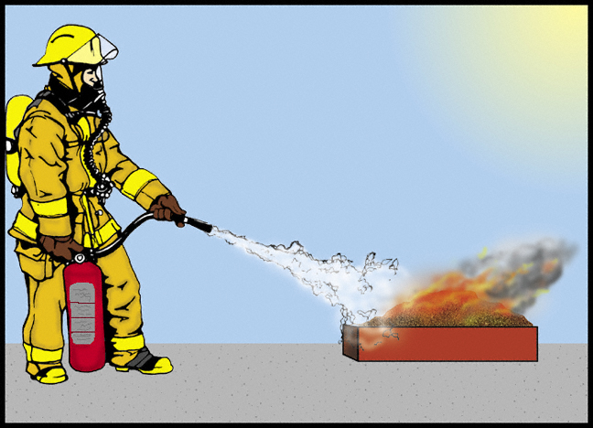
Make sure to aim at the base of the flame!

Slide 7
Fire Extinguisher Capacity Rating
For a 2A:10 BC Extinguisher
2A:10 BC – Recommended Capacity for Homes
Number in Front of the “A”
Equals to Equivalent Number of Units for 1.25 Gallons of Water
2A Equals 2.5 Gallons of Water
(2 x 1.25 Gallons = 2.5 Gallons)
Number in Front of the “BC”
Area in Sq. Ft. that a non-expert is able to extinguish a Class B or Class C Fire
10BC = 10 Square Feet

Slide 8
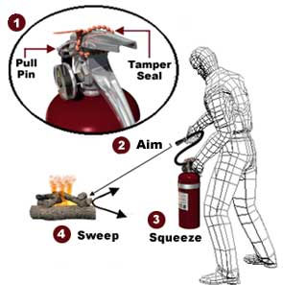
How to Use a Fire Extinguisher
Remember “PASS”
Stand 6 to 8 ft away
P: Pull the Pin
A: Aim at the Base of the Flame
S: Squeeze the Handle
S: Sweep from Side to Side
Step Backwards When Done – Never Turn Your Back Towards an Extinguished Fire!

Slide 9
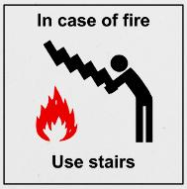
You are NOT Required to Use a
Fire Extinguisher on a Fire.
Your Responsibilities in a Fire Situation:
Recognize a Fire Condition
Activate the Fire Alarm System
Evacuate the Building
Call 9-911 to Report the Fire Condition
Prior to use: Make sure the fire extinguisher is fully charged and the needle is the green area.
Remember you are not a Trained Firefighter.
YOU SHOULD NEVER PUT YOUR LIFE IN DANGER!

